Slide 1

MemoMentor
Team Innovative Aspirants :
Nabin Khanal
Rajesh Bushal
Aashish Karki

Slide 2

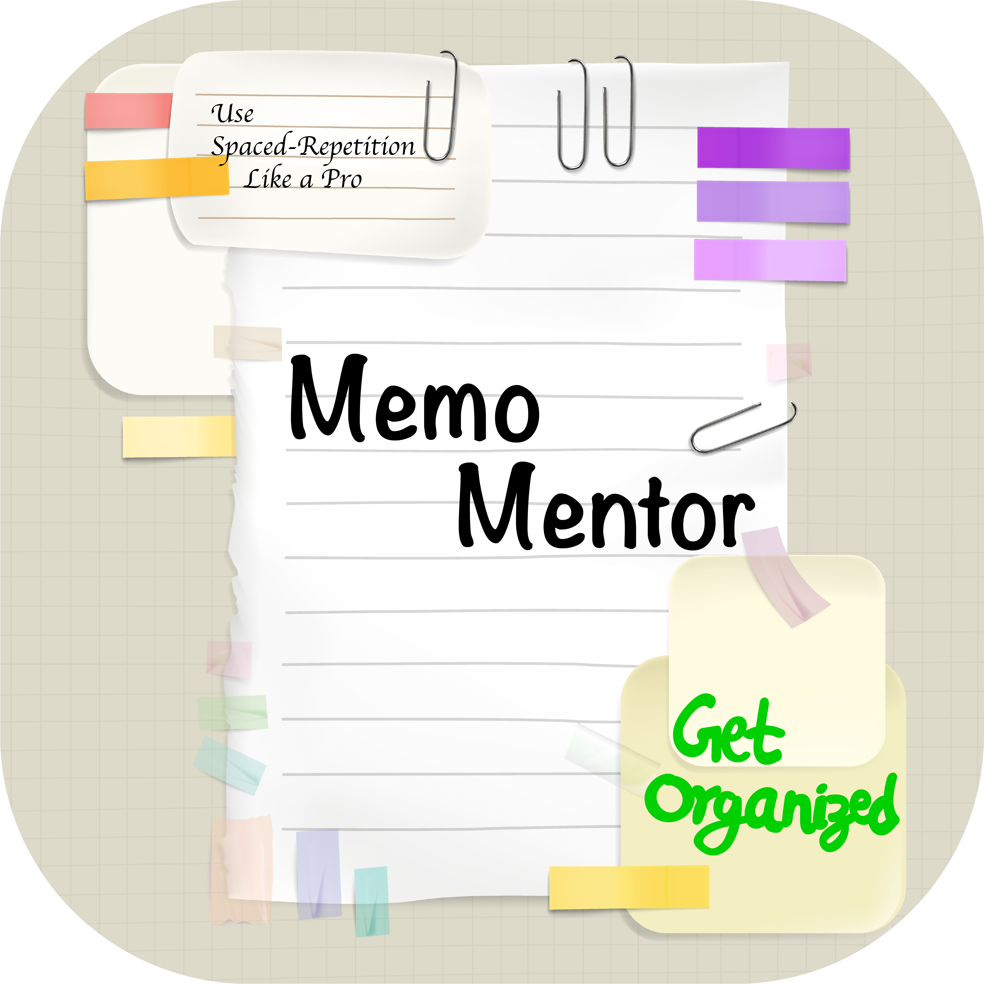

MemoMentor
intends to solve information retention problem of the students using a technique called Spaced-Repetition.

Slide 3

In 1885, Dr. Ebbinghaus came up with a ground breaking research which established the forgetting curve and the spaced repetition effect.
Basically, the slope of forgetting curve decreases over time and information can be stored for really large period of time with spaced repetition.

Slide 4

About our Web-App
It is a productivity app for students. This app will help student to perform active repetition effectively by notifying them on
Day 1, 3, 6, 18, and 1 month. Also it will serve as a
Assignment Organizer by notifying about deadlines of the assignments.

Slide 5
What our Web-App really does?
Takes input from the users what they learned in a particular day
Also can take information about the assignments and their deadlines
Generates daily schedule which comprise of scientifically scheduled revision notification [based on spaced repetition ].
Users can edit the to do list generated by the system.
Users can chat with a personal assistant Telegram bot which will notify them with their schedule.
Also Alerts users regarding the deadline of their assignment.

Slide 6
THANK YOU !

